Slide 1
FREEBIES FOR NEWBIES
A place to find free event and items
Client & Mentor:
Dr. Chandra Mouli Kotteti
Team Members:
Manoj Kumar Gude
Harish Chowdary Bala
Saibabu Devarapalli
Jaichand Mulakalapalli
Aditya Krishna Raavi
05

Slide 2
Meat our Team
JAICHAND MULAKALAPALLI
(TEAM LEADER) BACKEND
MANOJ KUMAR GUDE
FRONTEND
ADITHYA KRISHNA RAAVI
FRONTEND
Saibabu devarapalli
Fullstack
HARISH CHOWDARY BALA
DATABASE
DR. CHANDRA MOULI KOTTETI
Mentor & Client

Slide 3
SendGrid Email API: Prerequisites
List the requirements needed to complete the tutorial, including:
An app created at Back4App.
Back4App Command Line Configured with the project (Optional to upload codes).
Account created in SendGrid.
Installing Parse SDK at your project:
Android Studio Project.
iOS project (Swift - Objective-C).

Slide 4
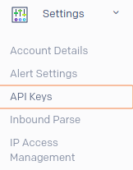
Creating SendGrid API Key
Access your account at https://app.sendgrid.com/
Locating the Settings drop-down menu and selecting the API Keys option
Fig. 1.1: Settings drop-down menu

Slide 5
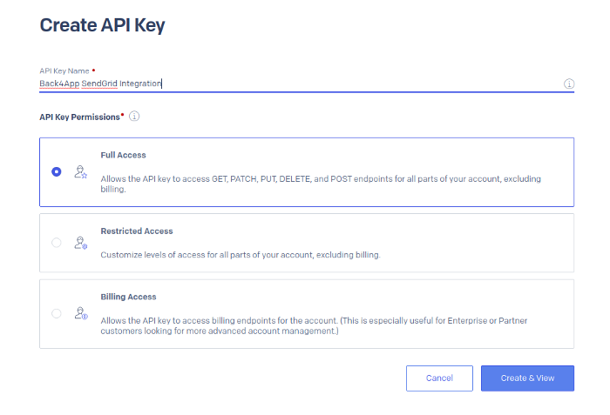
Creating SendGrid API Key
Choosing an identification to the API Key Name and allowing Full Access.
Fig. 1.2: API Key Creation Page

Slide 6

Creating SendGrid API Key
Clicking on Create & View and copying the generated key
Fig. 1.3: API Key Generation

Slide 7

Any Questions?

Slide 8




Slide 9
Team Members
JAICHAND MULAKALAPALLI
(TEAM LEADER) BACKEND
MANOJ KUMAR GUDE
FRONTEND
ADITHYA KRISHNA RAAVI
FRONTEND
Saibabu devarapalli
Fullstack
HARISH CHOWDARY BALA
DATABASE
DR. CHANDRA MOULI KOTTETI
Mentor & Client

Slide 10
FREEBIES FOR NEWBIES
A place to find free event and items
Client & Mentor:
Dr. Chandra Mouli Kotteti
Team Members:
Manoj Kumar Gude
Harish Chowdary Bala
Saibabu Devarapalli
Jaichand Mulakalapalli
Aditya Krishna Raavi
05

